Slide 1

Stock Price Prediction: A Comparative Study between Traditional Statistical Approach and Machine Learning Approach
4th International Conference on Electrical Information and Communication Technology (EICT)
Authors: 1. Indronil Bhattacharjee Department of CSE, KUET 2. Pryonti Bhattacharja
Department of Economics, SUST
Paper Id : 201
Presented by : Indronil Bhattacharjee

Slide 2
Outlines
Introduction
Objectives
Methodologies
Proposed System
Results and Discussions
Conclusion
References

Slide 3
Introduction
Stock market is an aggregation stockbrokers and traders who can buy and sell shares of stocks.
Stock data is non-stationary, chaotic, random and depends on several technical parameters.
Since statistical approaches are linear in nature, it hampers prediction performances in case of sudden rise or fall of prices of the stocks.
In modern days of artificial intelligence, machine learning plays an important role in time series predictions.

Slide 4
Objectives
To predict stock prices using both statistical and machine learning approaches.
To make comparison between statistical and machine learning approach predictions.
To find a better approach, which predicts prices of the stocks more accurately

Slide 5
Methodologies
Statistical Methods
Simple Moving Average
Weighted Moving Average
Exponential Smoothing
Naïve Approach (Last Value Method)
Machine Leaning Methods
Regression (Simple Linear, Lasso, Ridge)
K-Nearest Neighbour
Random Forest
Support Vector Machine (Support Vector Regression)
Neural Network Models (Single Layer Perceptron, Multilayer Perceptron, Long Short Term Memory)

Slide 6
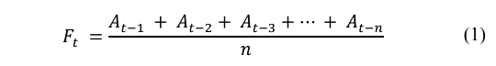
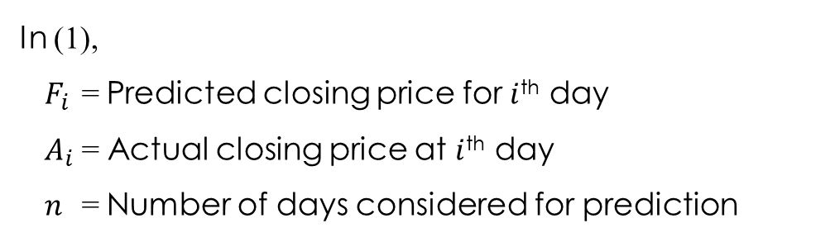
Simple Moving Average
An unweighted mean of a specific number of previous data is considered to be the predicted value for the next day.
The formula used for SMA-
In (1),
$F_{i}$ = Predicted closing price for $i$^{th} day
$A_{i}$ = Actual closing price at $i$^{th} day
$n$ = Number of days considered for prediction

Slide 7
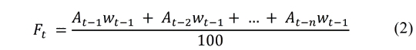
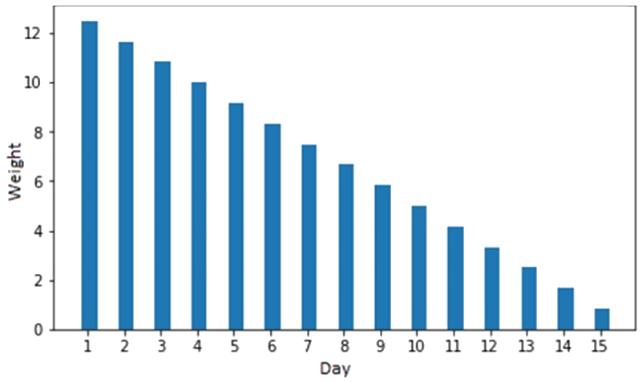
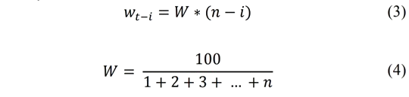
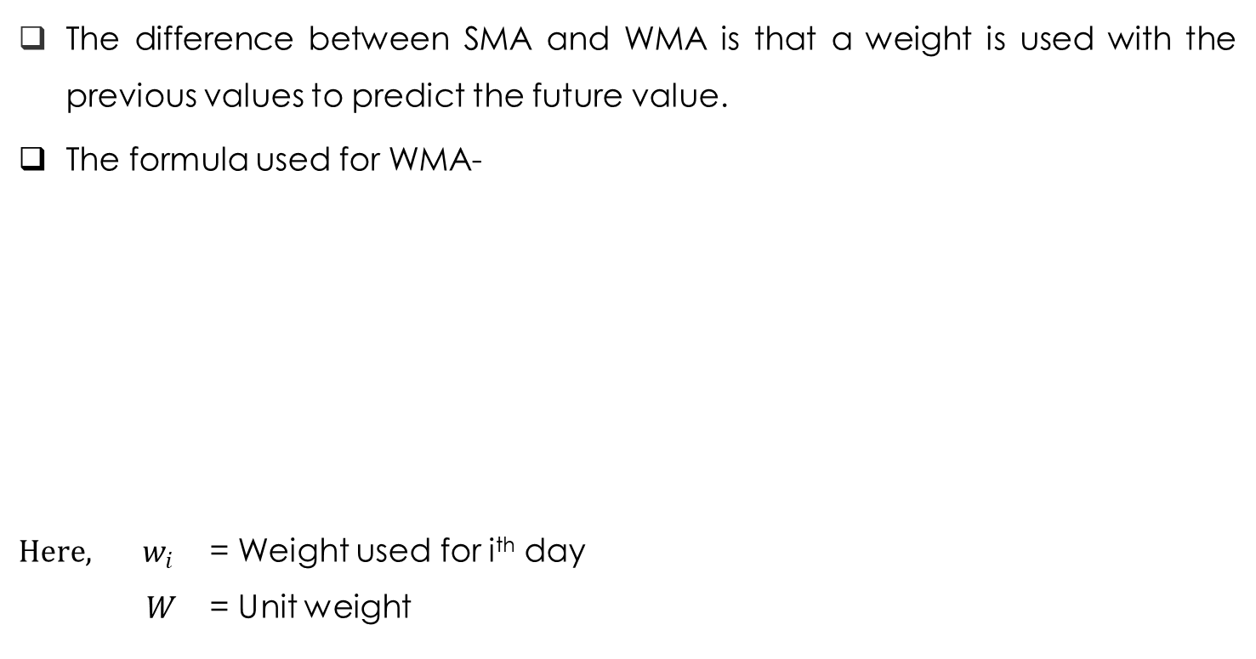
Weighted Moving Average
The difference between SMA and WMA is that a weight is used with the previous values to predict the future value.
The formula used for WMA-
${Here, w}_{i}$ = Weight used for i^{th} day
$W$ = Unit weight
Fig. Weights for $i$^{th} last day of 15-day WMA

Slide 8
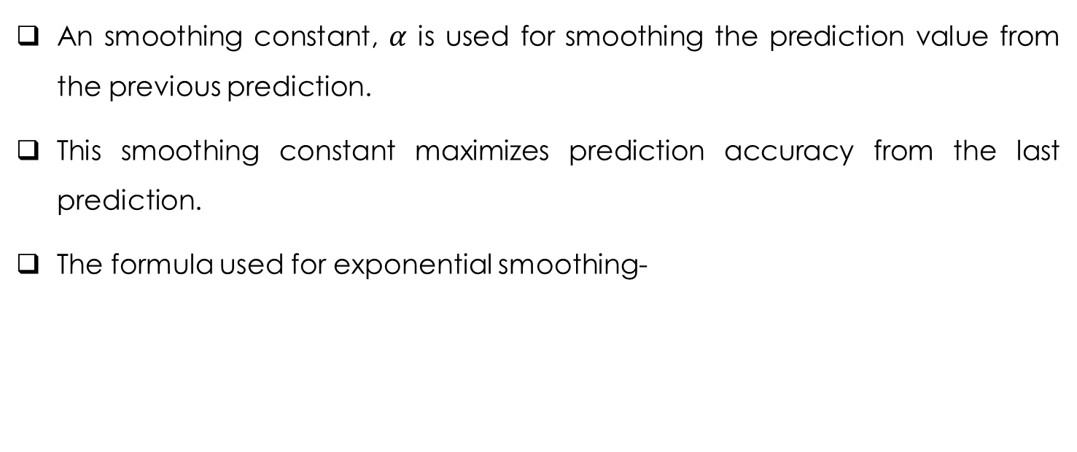

Exponential Smoothing
An smoothing constant, $α$ is used for smoothing the prediction value from the previous prediction.
This smoothing constant maximizes prediction accuracy from the last prediction.
The formula used for exponential smoothing-
Here,
$α$= Smoothing constant

Slide 9
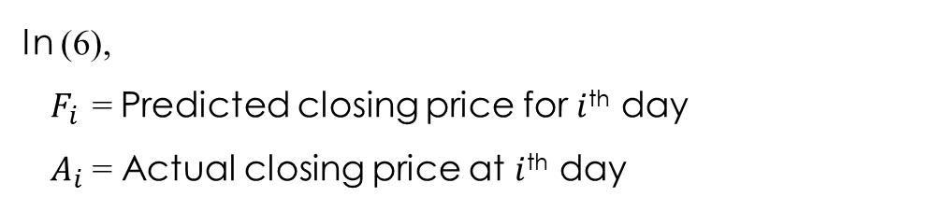
Naïve Approach
Naive approach is also called the Last Value method.
The last actual value is considered as the predicted value for the next day.
The formula used for Naive approach-
In (6),
$F_{i}$ = Predicted closing price for $i$^{th} day
$A_{i}$ = Actual closing price at $i$^{th} day

Slide 10
Regression (Simple Linear, Lasso, Ridge)
Simple linear regression algorithm is one of the fundamental supervised machine learning algorithms used for regression.
Ridge is one of the techniques which reduces model complexity and prevents over-fitting.
Lasso stands for Least Absolute Shrinkage and Selection Operator. Lasso finds the central point where data values are shrunk.

Slide 11
K-Nearest Neighbour
Algorithm to predict numerical target based on a similarity measure.
KNN calculates the average of the numerical target of the K nearest neighbors.

Slide 12
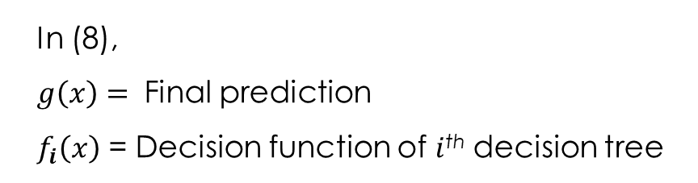
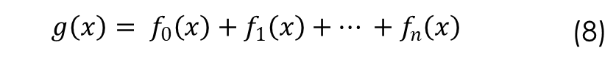
Random Forest
Random Forest algorithm is one of the ensemble learning algorithms.
It is an additive model that makes prediction by combining decisions of a sequence of decision trees.
Random forest prediction formula is as follows-
$$g\left(x\right)= f_{0}\left(x\right)+f_{1}\left(x\right)+… +f_{n}\left(x\right)$$ | (8)
In (8),
$g\left(x\right)=$ Final prediction
$f_{i}\left(x\right)$ = Decision function of $i$^{th} decision tree

Slide 13
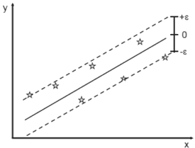
Support Vector Machine (Support Vector Regression)
SVM can be used as regression method.
Support Vector Regression uses the same principles as the SVM for classification, with only a few minor differences.
A margin of tolerance (ϵ) is set in approximation to the SVM.
Fig. Support Vector Machine

Slide 14
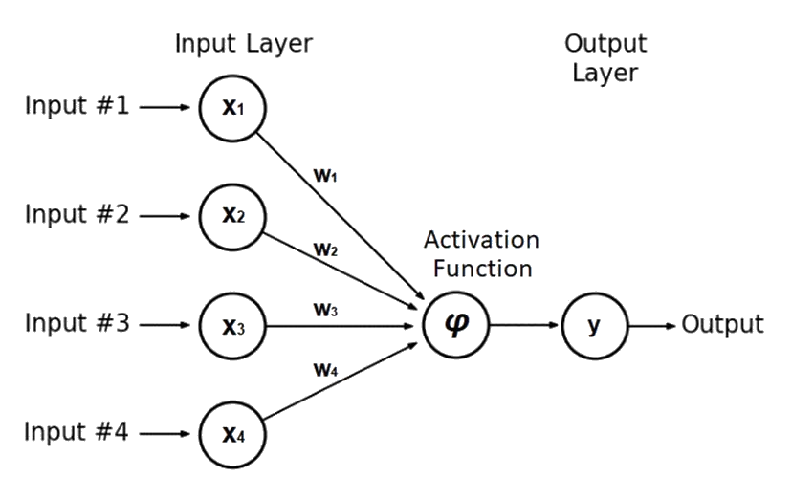
Neural Network Models (Single Layer Perceptron)
Single Layer Perceptron model is a neural network model which consists of only one input layer and one output layer.
There will be no hidden neuron layer in between.
Fig. Single Layer Perceptron

Slide 15
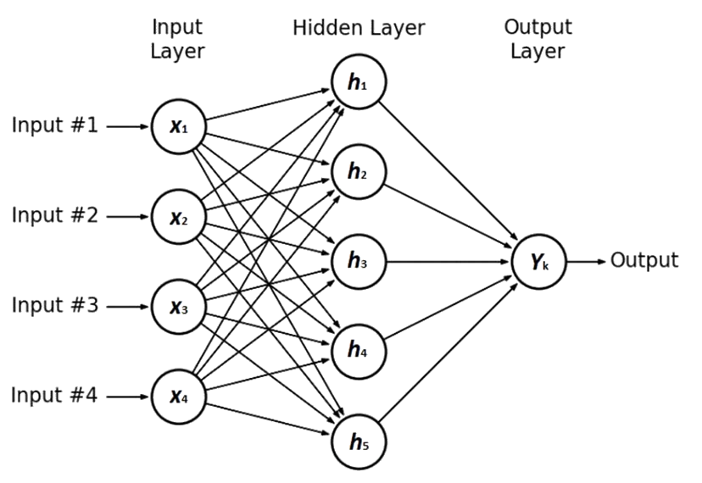
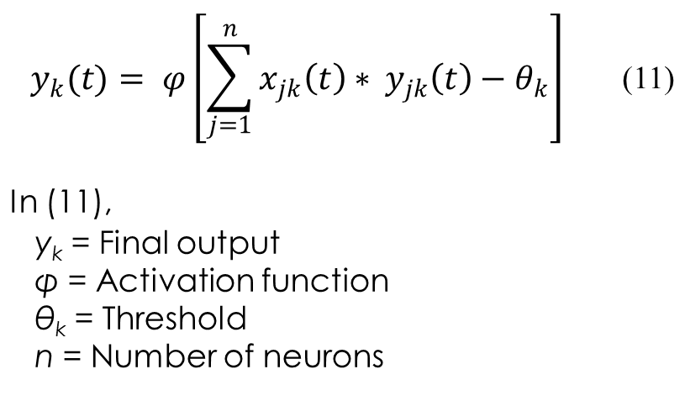
Neural Network Models (Multilayer Perceptron)
There will be one or more hidden layers present in between one input layer and one output layer in an MLP model.
$$y_{k}(t)= φ{\left[\sum_{j=1}^{n}{x_{jk}\left(t\right)∗ }y_{jk}\left(t\right)−θ_{k}\right]}^{ }$$ | (11)
In (11), y_{k} = Final output φ = Activation function θ_{k} = Threshold n = Number of neurons
Fig. Multilayer Perceptron

Slide 16
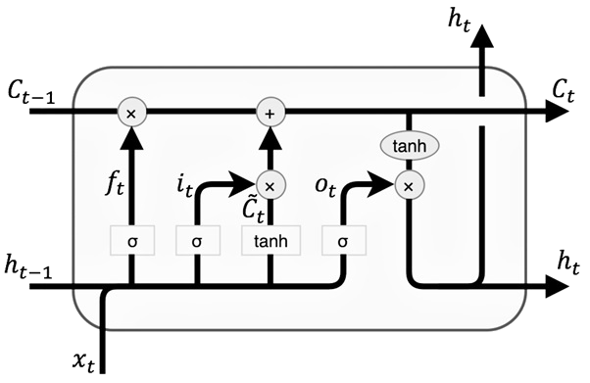
Neural Network Models (LSTM)
LSTM is associated with Recurrent Neural Network.
It introduces memory unit, forget gate and update gate with simple RNN.
Fig. LSTM

Slide 17
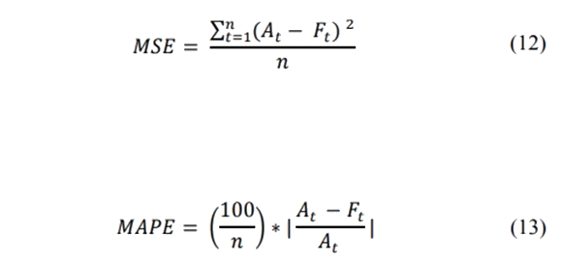
Performance Measures
Mean Squared Error (MSE)
Mean Absolute Percentage Error (MAPE)

Slide 18
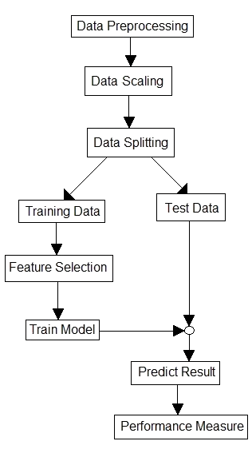
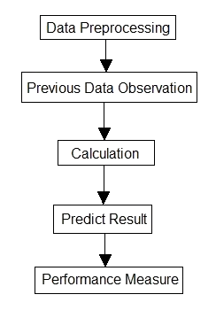
The Proposed System
Fig. Flow diagram of statistical methods
Fig. Flow diagram of machine learning methods

Slide 19

Dataset
We have used two datasets (a) Stock Prices of Tesla
Start : 29-06-2010
End : 17-03-2017
Days : 1693
(b) Stock Prices of Apple
Start : 02-01-2014
End : 31-12-2018
Days : 1259 Data collected from www.kaggle.com

Slide 20
Dataset (Continued)
Each row represents the information of a single day.
There are six columns for each row.
1st column - the date
2nd column - the opening price of that day
3rd column - the highest price of that day
4th column - the lowest price of that day
5th column - the closing price of that day
6th column - the volume of shares traded on that day.

Slide 21
Data Preprocessing
Data preprocessing includes-
Checking out for missing values and discards those data from the dataset
Looking for categorical values
Drop out unnecessary information in the dataset.

Slide 22
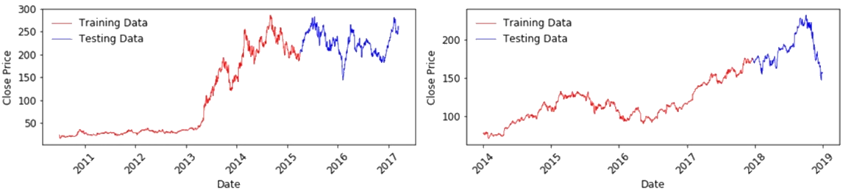
Data Splitting
The dataset has been split into two parts as training data and test data.
For Tesla dataset,
Training Data (1200 days): 29-06-2010 to 06-04-2015
Testing Data (492 days): 07-04-2015 to 17-03-2017
(b) For Apple dataset,
Training Data (1000 days): 02-01-2014 to 19-12-2017
Testing Data (258 days): 20-12-2017 to 31-12-2018

Slide 23
Feature Selection
For time series prediction, selection of features is an important task.
Because selection of worst features can direct the prediction to a wrong way.
In this system, three features have been selected.
The opening price
The highest price
The lowest price.

Slide 24
Prediction
As statistical methods, predictions have been performed using 10-day, 15-day, 30-day Simple Moving Average and Weighted Moving Average, Exponential Smoothing with α = 0.3, 0.5, 0.75 and naïve approach.
As Machine Learning methods, predictions have been performed using Simple Linear Regression, Lasso Regression and Ridge Regression, K-Nearest Neighbor, Random Forest with different number of estimators, Support Vector Machine and Neural Network Models like SLP, MLP and LSTM.
After predictions, MSE and MAPE values are calculated.

Slide 25
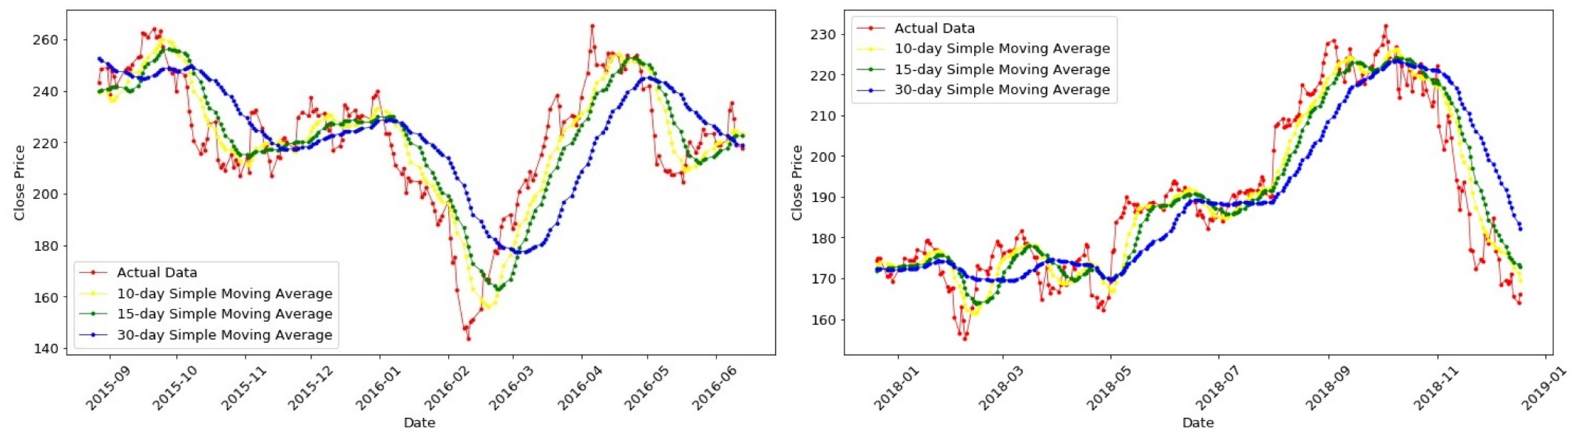
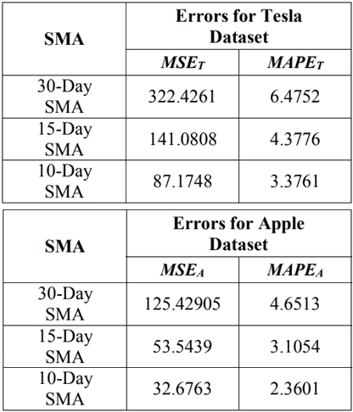
Results and Discussions
Table I. Performance Measures of Different Simple Moving Average Methods

Slide 26
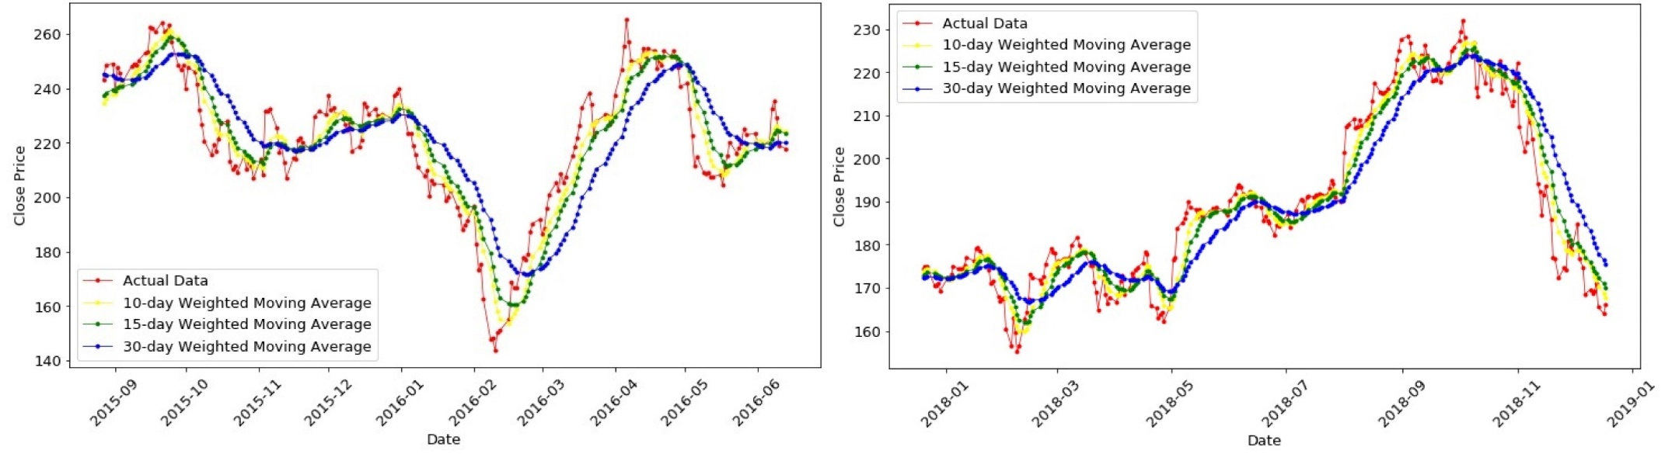
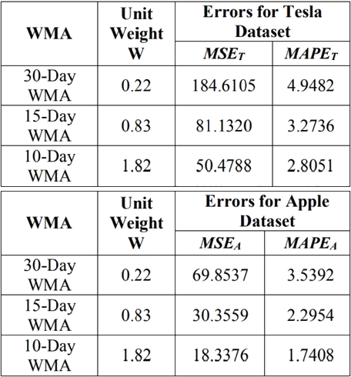
Results and Discussions (Continued)
Table II. Performance Measures of Different Weighted Moving Average Methods

Slide 27
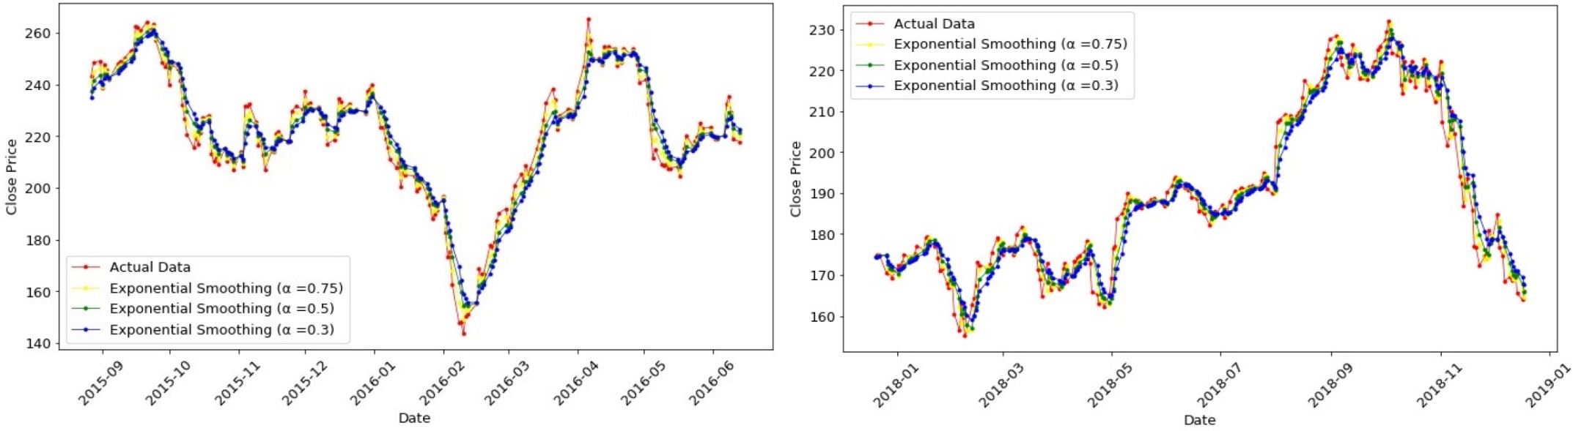
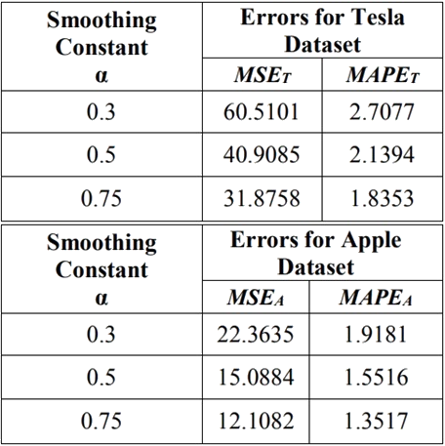
Results and Discussions (Continued)
Table III. Performance Measures of Exponential Smoothing Method with Different Smoothing Constants

Slide 28
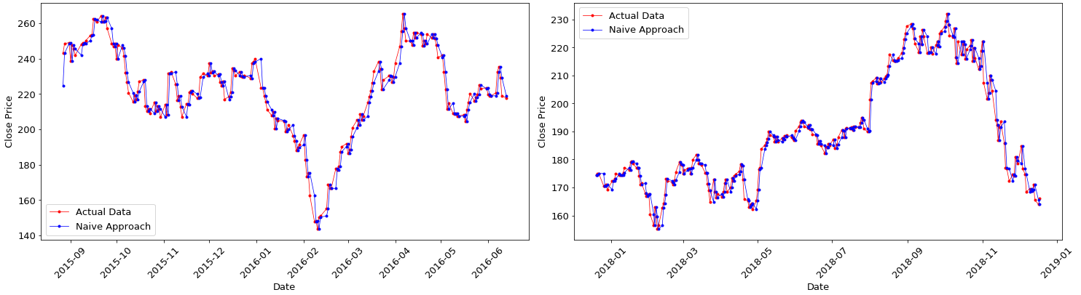
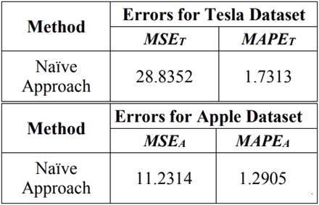
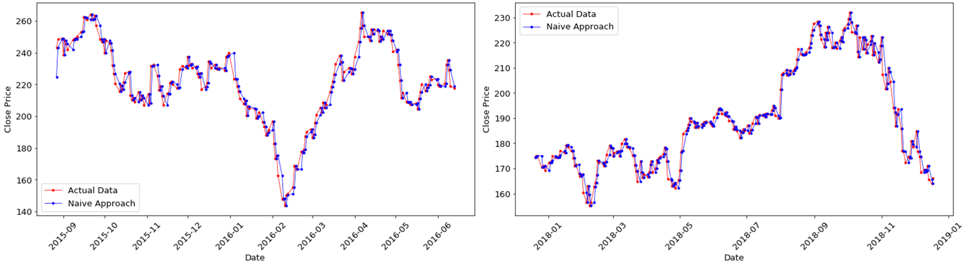
Results and Discussions (Continued)
Table IV. Performance Measures of Naïve Approach Method

Slide 29
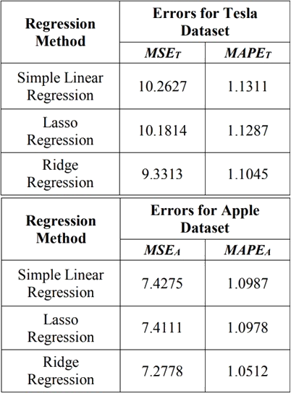
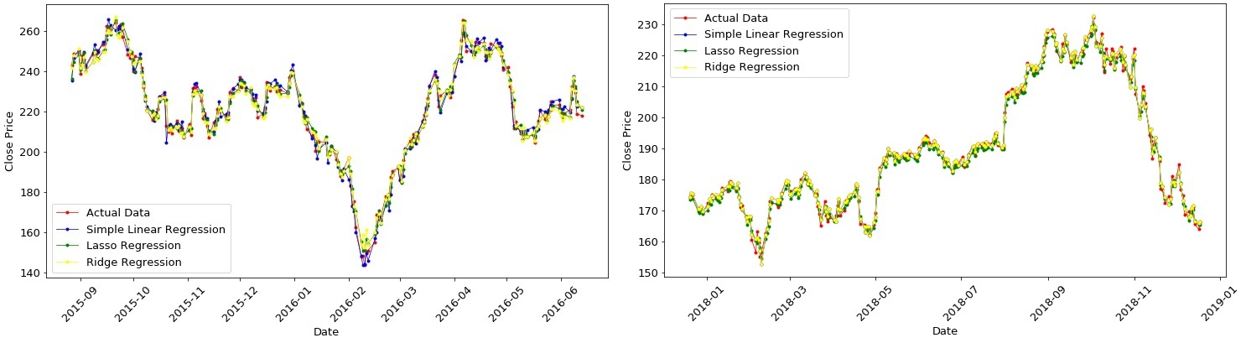
Results and Discussions (Continued)
Table V. Performance Measures of Different Regression Methods

Slide 30
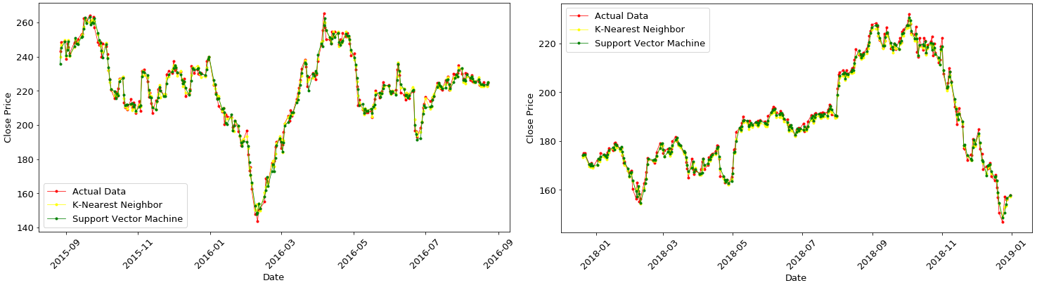
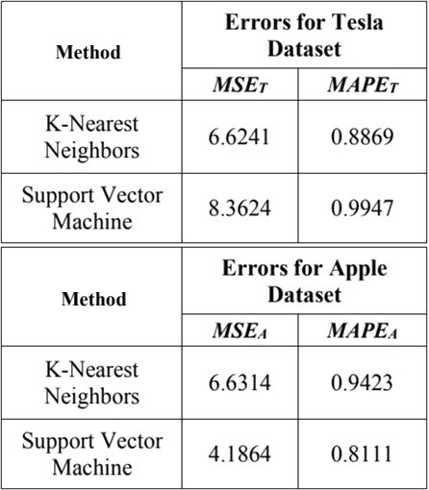
Results and Discussions (Continued)
Table VI. Performance Measures of KNN and SVM

Slide 31
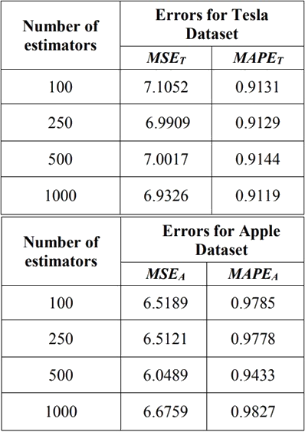
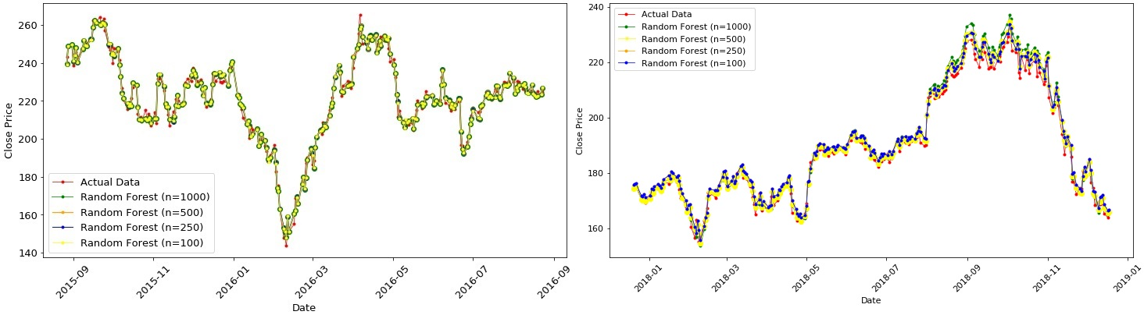
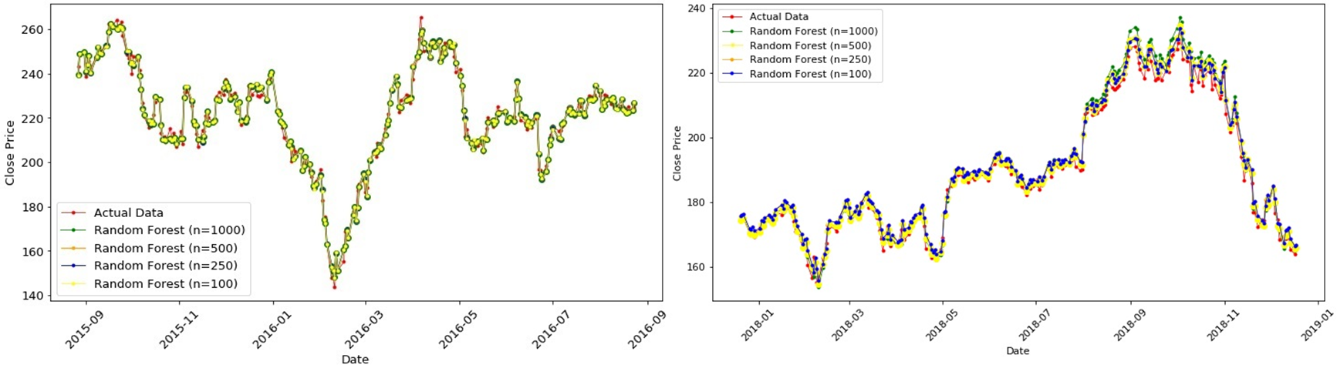
Results and Discussions (Continued)
Table VII. Performance Measures of Random Forest with Different Number of Estimators

Slide 32
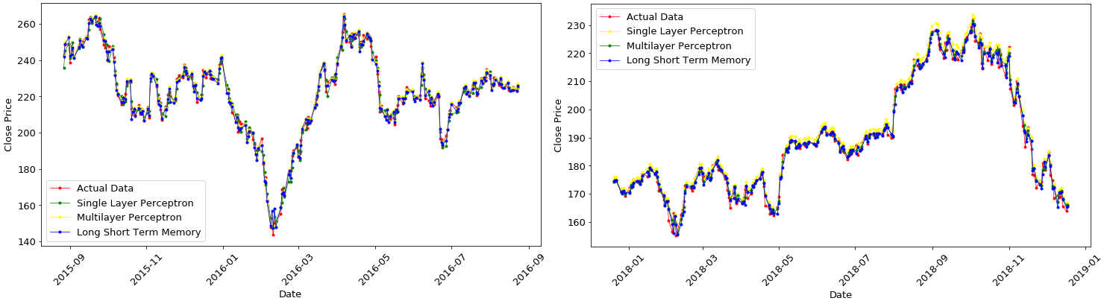
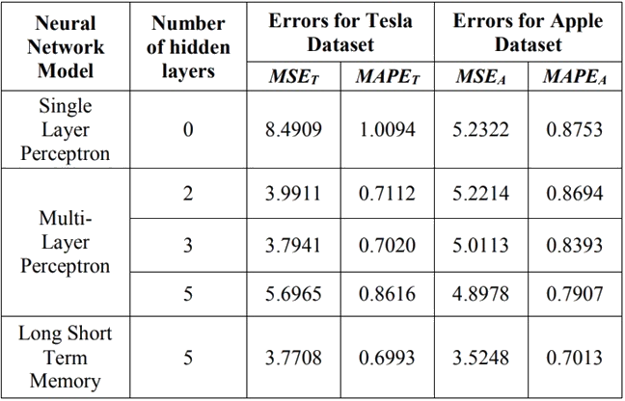
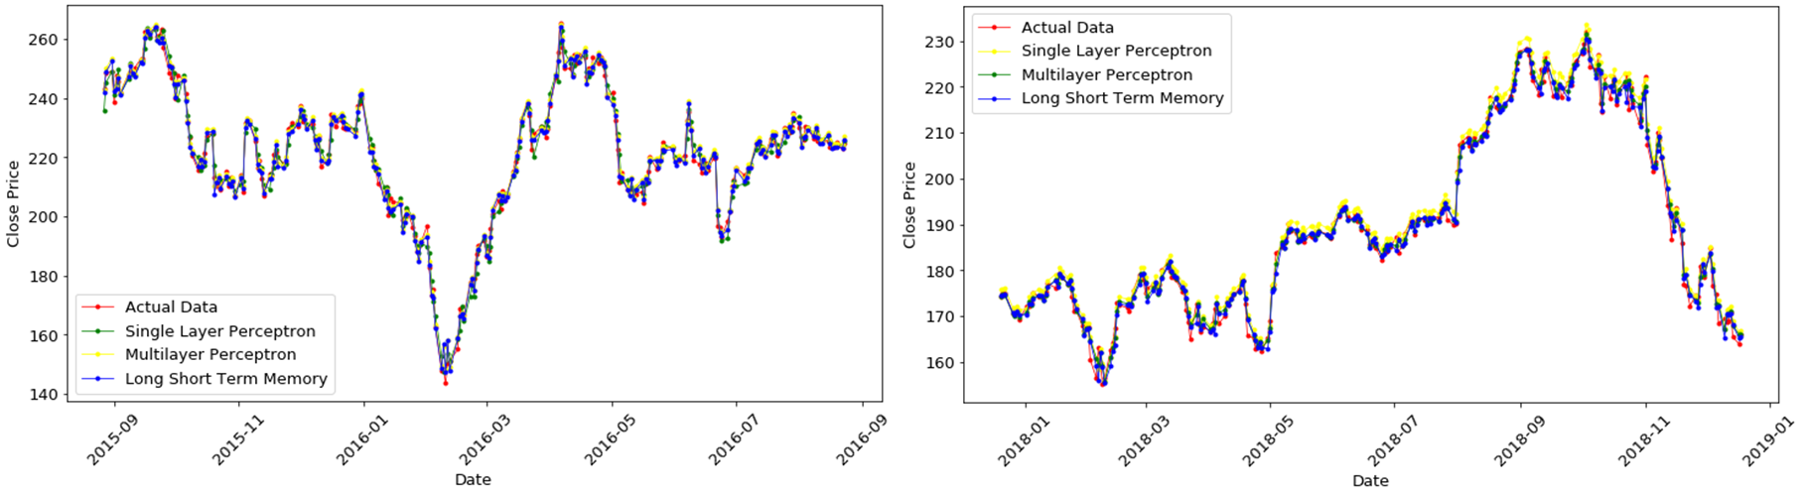
Results and Discussions (Continued)
Table VIII. Performance Measures of Different Neural Network Models

Slide 33
Conclusion
A comparative study between statistical approaches and machine learning approaches has been done in terms of prediction performances.
Machine learning methods, especially, MLP and LSTM are found to be the most accurate to predict stock prices.

Slide 34
References
R. S. Dhankar, Capital Markets and Investment Decision Making, 1st ed. Springer India, 2019, ch. Stock Market Operations and Long-Run Reversal Effect.
M. Usmani, S. H. Adil, K. Raza, and S. S. A. Ali, “Stock market prediction using machine learning techniques,” in 2016 3rd International Conference on Computer and Information Sciences (ICCOINS), Aug 2016, pp. 322–327.
H. Grigoryan, “A stock market prediction method based on support vector machines (svm) and independent component analysis (ica),” Database Systems Journal, vol. 7, no. 1, pp. 12–21, 2016.
S. Hansun, “A new approach of moving average method in time series analysis,” in 2013 International Conference on New Media Studies, CoNMedia 2013, Nov 2013, pp. 1–4.
E. Ostertagova and O. Ostertag, “The simple exponential smoothing model,” 09 2011.

Slide 35
References (Continued)
Saptashwa, “Ridge and Lasso Regression: A Complete Guide with Python Scikit-Learn,”https://towardsdatascience.com/ridge-and-lassoregressiona-complete-guide-with-python-scikit-learn-e20e34bcbf0b, Sep 26, 2018.
D. S. Sayad, “K Nearest Neighbors - Regression,” http://saedsayad.com/k nearest neighbors reg.htm.
J. Patel, S. Shah, P. Thakkar, and K. Kotecha, “Predicting stock market index using fusion of machine learning techniques,” Expert Syst. Appl., vol. 42, pp. 2162–2172, 2015.
D. S. Sayad, “Support Vector Machine - Regression (SVR),” https://www.saedsayad.com/support vector machine reg.htm.
S. Rathor, “Simple RNN vs GRU vs LSTM :- Difference lies in More Flexible control,” https://medium.com/@saurabh.rathor092/simplernnvs-gru-vs-lstm-difference-lies-in-more-flexible-control5f33e07b1e57, Jun 2, 2018.

Slide 36
Any Questions Please…?

Slide 37
THANK YOU

